Slide 1
More on CNN
Biplab Banerjee

Slide 2
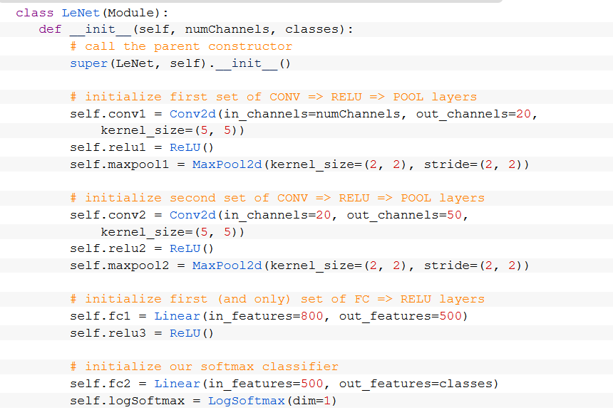

Slide 3
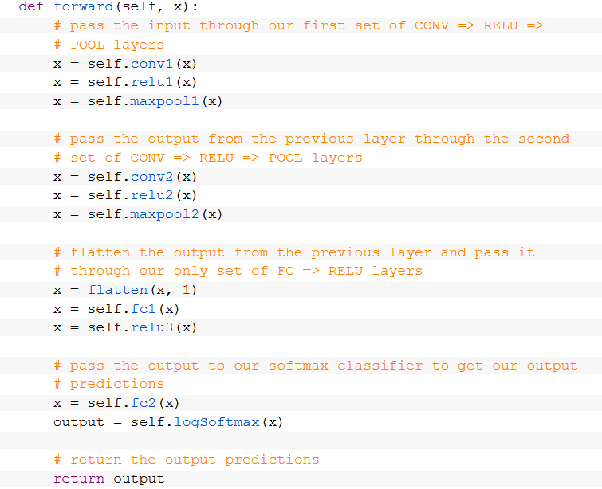

Slide 4
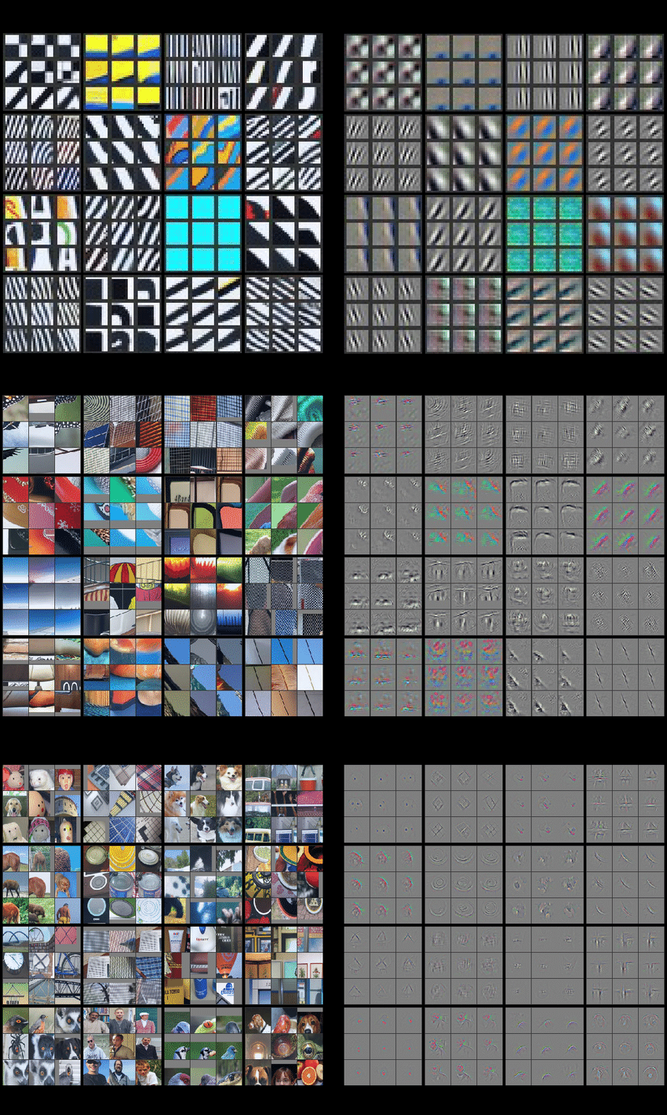
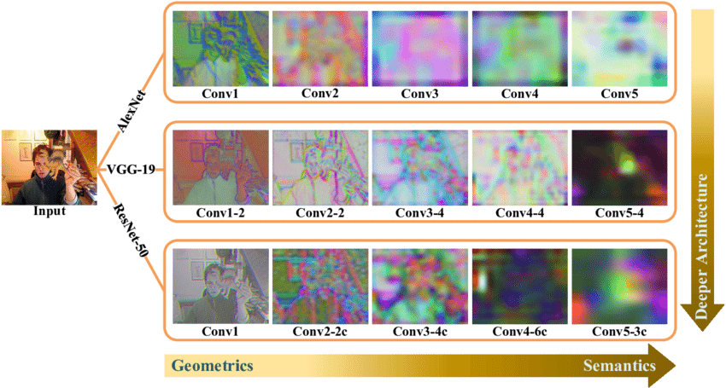

Slide 5
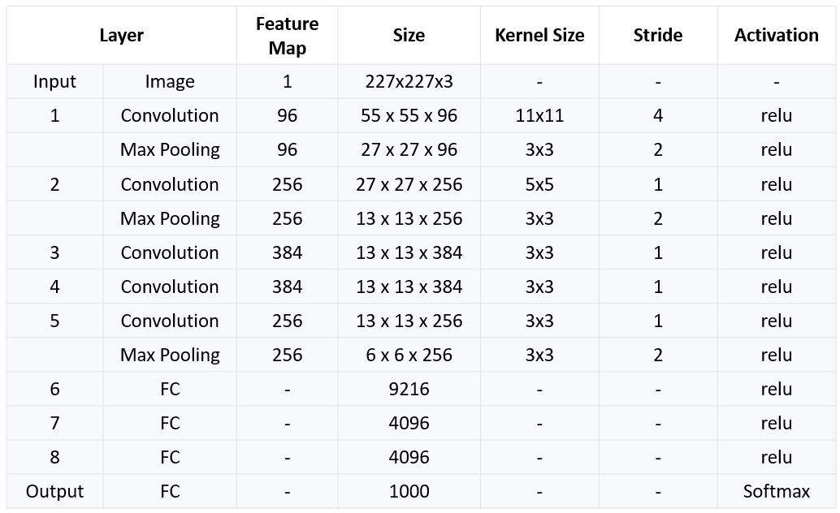

Slide 6
Some insights
Translation invariance vs equivariance
Feature hierarchy learning in CNN
Requires loads of images
What happens if we do not engineer the model properly?

Slide 7
Issues in CNN
Weight initialization
Normalization
Regularization
Some intuitive CNN architectures

Slide 8
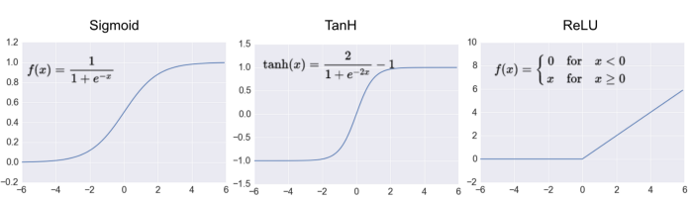
Saturation problem with activations

Slide 9
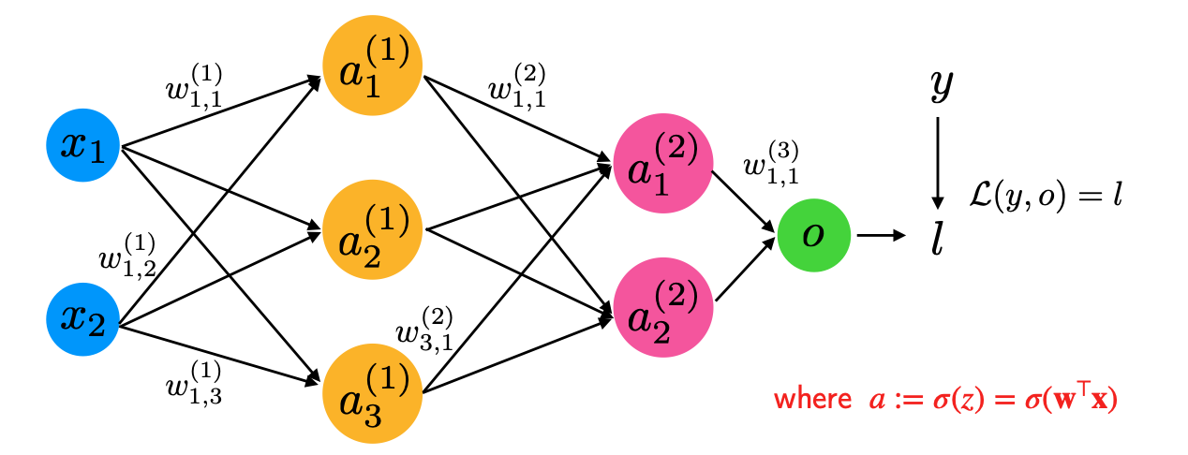
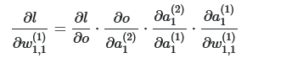
Vanishing and exploding gradients

Slide 10
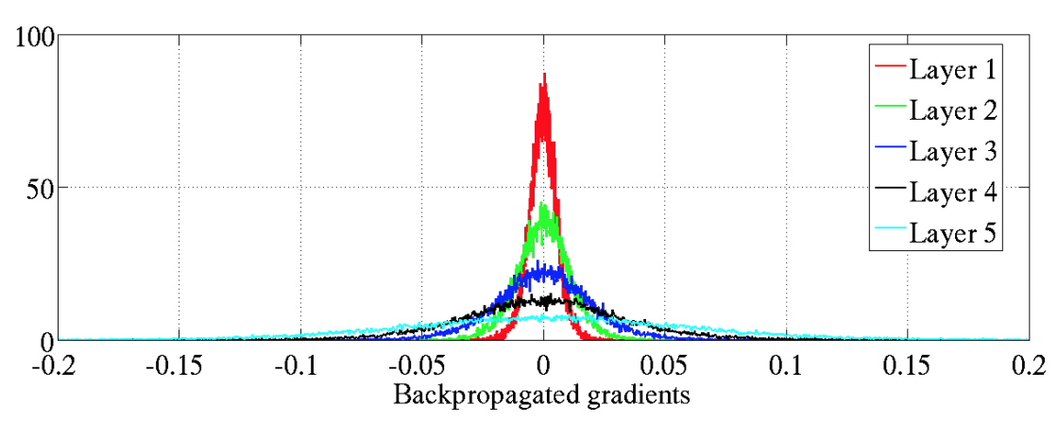

Slide 11
Ways to deal with them
Vanishing gradients
Use proper activations
Smaller network (if using sigmoid/tanh type activations)
Proper initialization
Exploding gradients
Weight clipping
Proper initialization
Model engineering

Slide 12
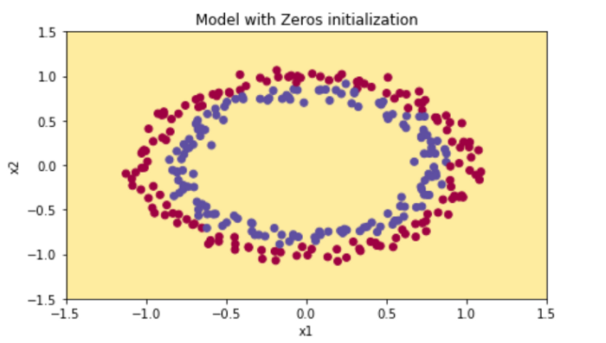
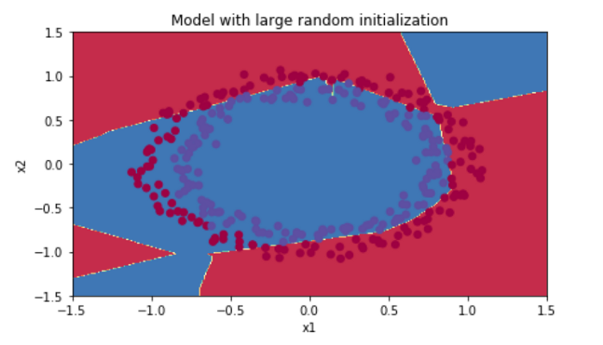
Problems with standard initializations
Zero initialization – All neurons learn the same values
Random initialization – Saturation problem for sigmoid/tanh

Slide 13
Initialization
Need for initialization
He initialization
Interlude: Expectations
Show that
Write variance of pre-activations f’ in terms of activations h in previous layer
Write variance of pre-activations f’ in terms of pre-activations f in previous layer

Slide 14
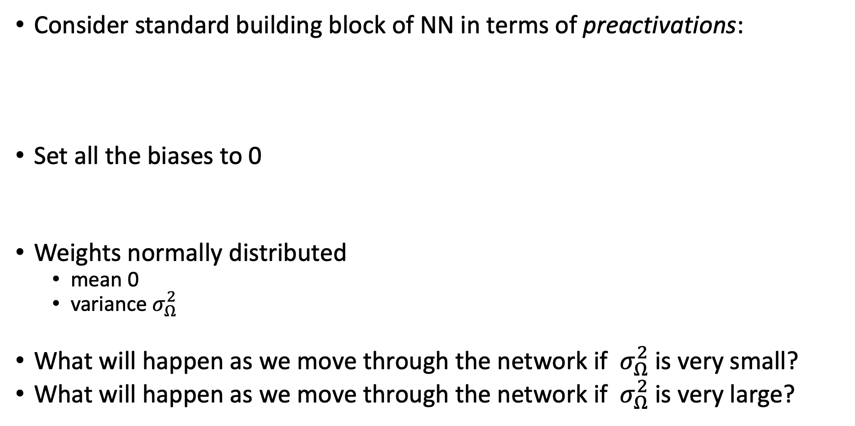
Initialization
Consider standard building block of NN in terms of preactivations:
Set all the biases to 0
Weights normally distributed
mean 0
variance${{ σ}_{Ω}^{2}}_{ }$
What will happen as we move through the network if ${ σ}_{Ω}^{2}$is very small?
What will happen as we move through the network if ${ σ}_{Ω}^{2}$is very large?

Slide 15
Aim: keep variance same between two layers
Consider the mean of the pre-activations:

Slide 16
Rule 1:
Rule 2:
Rule 3:
Rule 4:

Slide 17
Rule 1:
Rule 2:
Rule 3:
Rule 4:

Slide 18
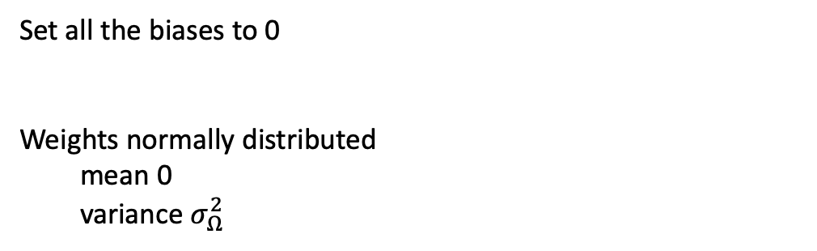
Rule 1:
Rule 2:
Rule 3:
Rule 4:
Set all the biases to 0
Weights normally distributed
mean 0
variance${{ σ}_{Ω}^{2}}_{ }$

Slide 19
Initialization
Need for initialization
He initialization
Interlude: Expectations
Show that
Write variance of pre-activations f’ in terms of activations h in previous layer
Write variance of pre-activations f’ in terms of pre-activations f in previous layer

Slide 20
Aim: keep variance same between two layers

Slide 21
Rule 1:
Rule 2:
Rule 3:
Rule 4:
Set all the biases to 0
Weights normally distributed
mean 0
variance${{ σ}_{Ω}^{2}}_{ }$

Slide 22
Rule 1:
Rule 2:
Rule 3:
Rule 4:
Set all the biases to 0
Weights normally distributed
mean 0
variance${{ σ}_{Ω}^{2}}_{ }$

Slide 23
Rule 1:
Rule 2:
Rule 3:
Rule 4:
Set all the biases to 0
Weights normally distributed
mean 0
variance${{ σ}_{Ω}^{2}}_{ }$

Slide 24
Rule 1:
Rule 2:
Rule 3:
Rule 4:
Set all the biases to 0
Weights normally distributed
mean 0
variance${{ σ}_{Ω}^{2}}_{ }$

Slide 25
Initialization
Need for initialization
He initialization
Interlude: Expectations
Show that
Write variance of pre-activations f’ in terms of activations h in previous layer
Write variance of pre-activations f’ in terms of pre-activations f in previous layer

Slide 26
Aim: keep variance same between two layers
Should choose:
This is called He initialization.

Slide 27
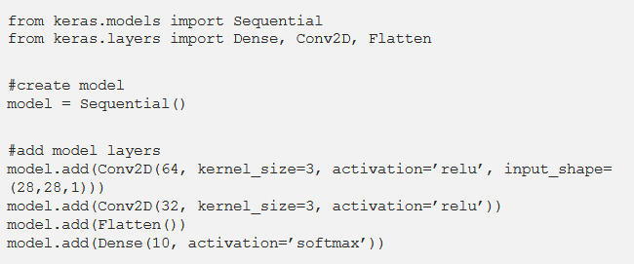
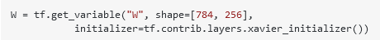

Slide 28
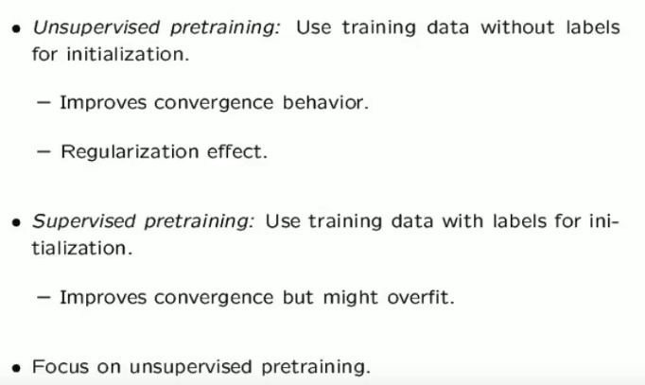
pre-training

Slide 29
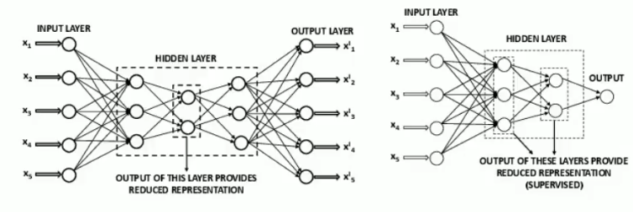

Slide 30
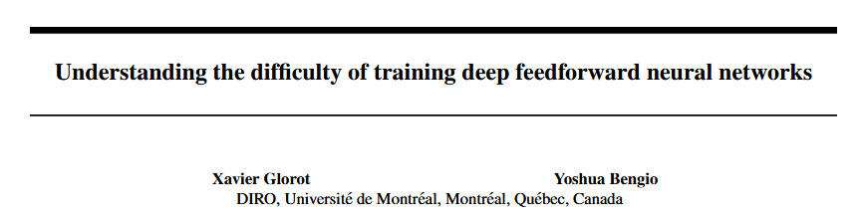
Suggested reading

Slide 31
Data normalization
Normalized data helps in stable training
It helps in dealing with internal covariate shift
Since the CNN is trained with BATCH of training samples, lets see the idea of batch gradient descent in back-propagation

Slide 32
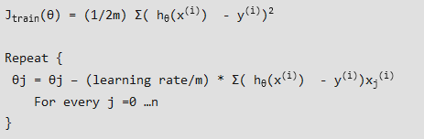
Batch gradient descent

Slide 33
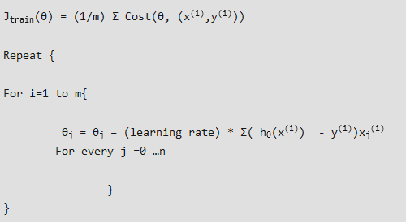
Stochastic gradient descent

Slide 34
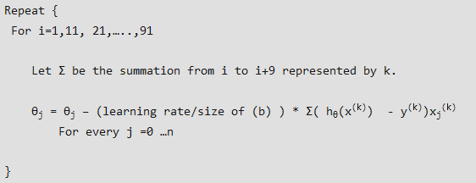
Mini-batch gradient descent

Slide 35
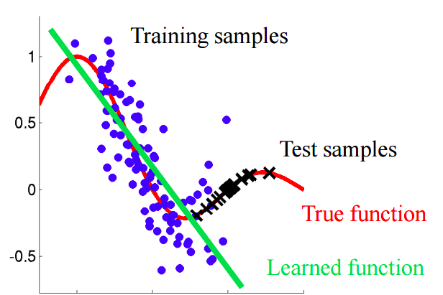
The idea of dataset (covariate) shift
“Internal Covariate Shift is the change in the distribution of network activations due to the change in network
parameters during training.”

Slide 36
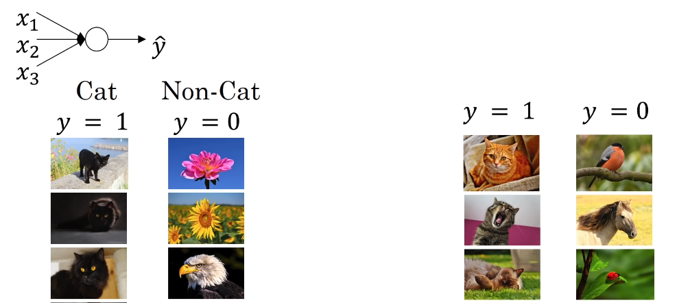

Slide 37
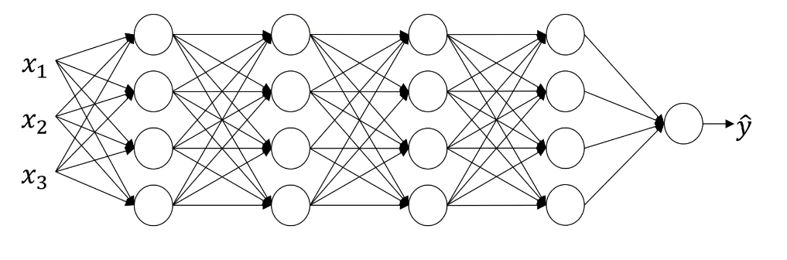
What does each layer weight see?
W1,b1
W2,b2
W3,b3
Inputs to layer 3 changes over time as (W1,b1) and (W2,b2) are also changing

Slide 38
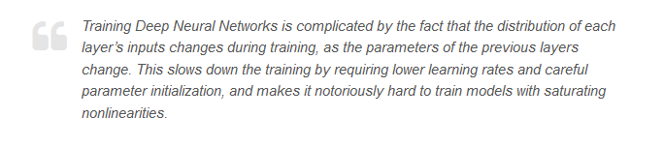
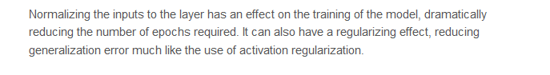
Batch-normalization

Slide 39
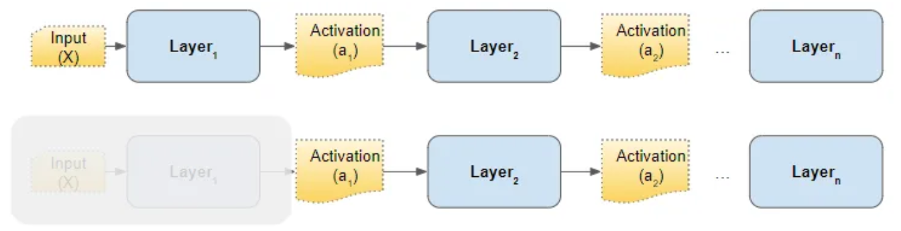

Slide 40
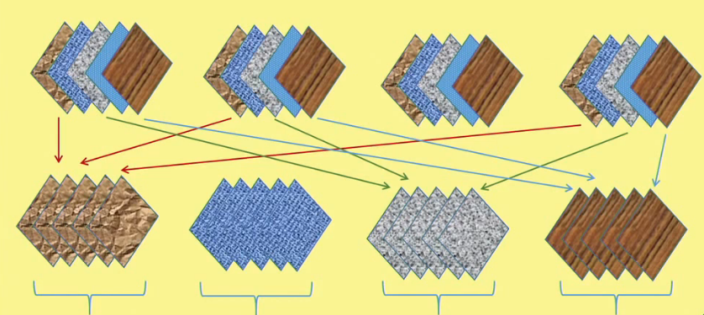
How BN works

Slide 41
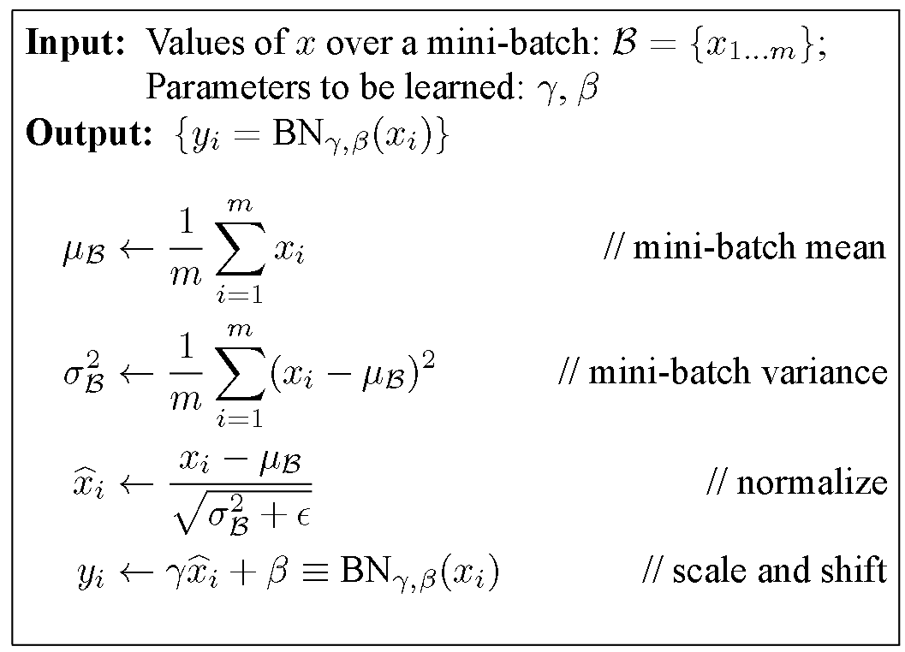

Slide 42
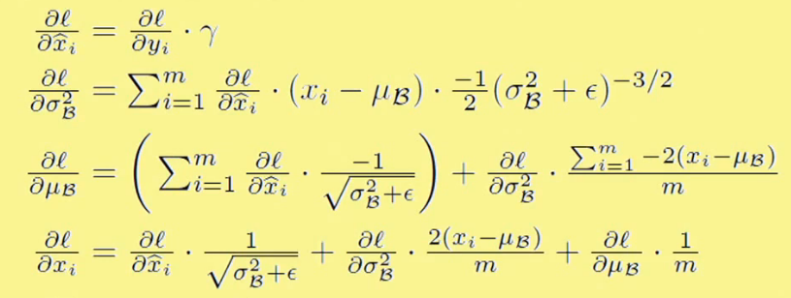
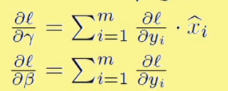

Slide 43
Advantages of BN
Speeds up training
Reduce dependence on weight initialization
Small regularization effect

Slide 44
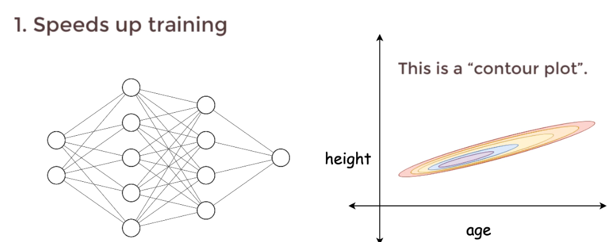
Speeds up training
In different batch, let us consider we have young to old people

Slide 45
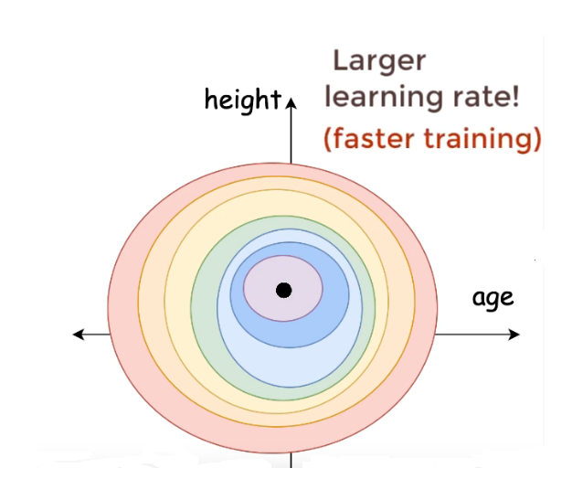
After standardization

Slide 46
Where can the BN not be used?
Small batch size – high noise in calculated batch mean and std!
Recurrent type models – separate batch-norm at each time-step!
Solutions?
Weight normalization
Layer normalization
Instance normalization
Spectral normalization
Group normalization
…

Slide 47
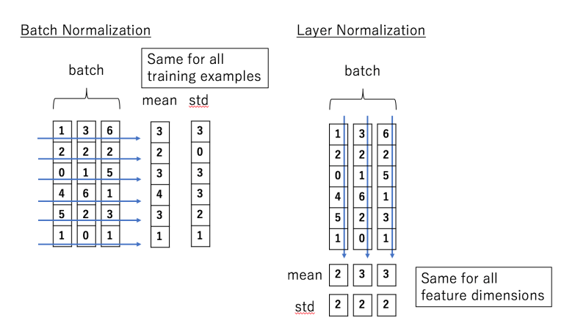
Layer normalization

Slide 48
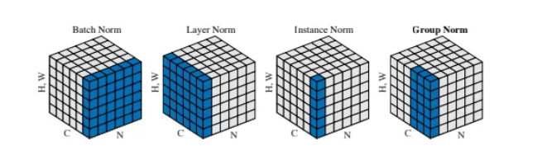
All together

Slide 49
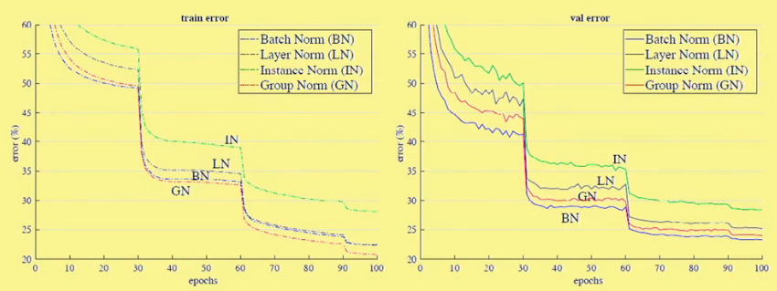
Comparison of different normalization (ECCV 18’)

Slide 50
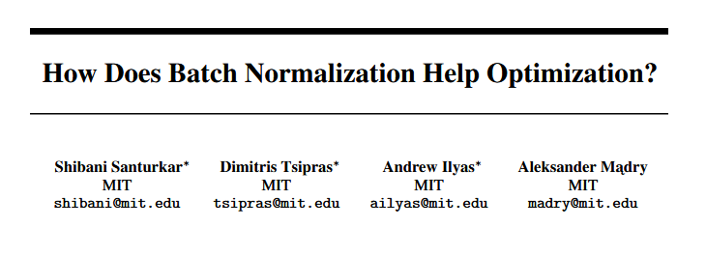
Suggested reading

Slide 51
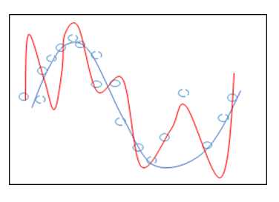
Model regularization
Less training data
Too many model parameters
Model overfitting
Regularization – ways to avoid overfitting

Slide 52
Regularization ways
We have to ensure that the model does not overfit the training data – does not memorize the training samples
Restrict the values the model parameters can take (lasso, ridge regressions)
Ensemble model – mixture of experts

Slide 53
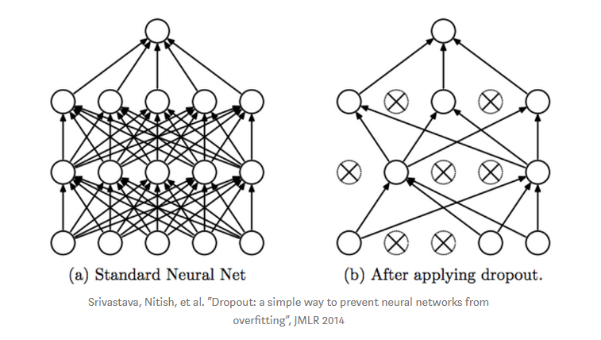
Dropout regularization

Slide 54
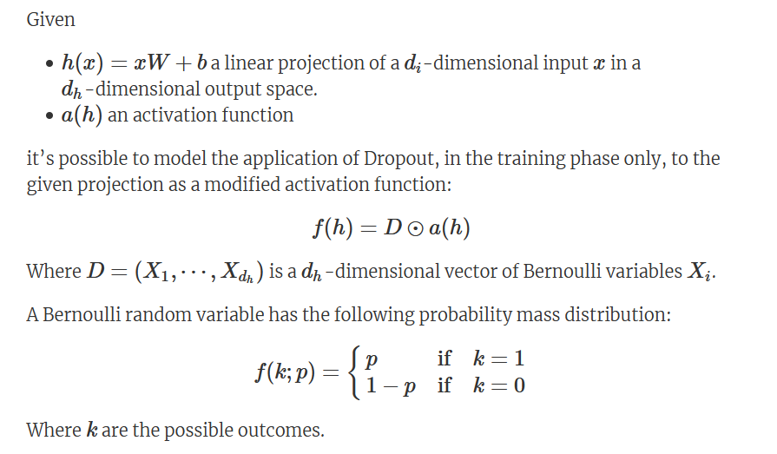
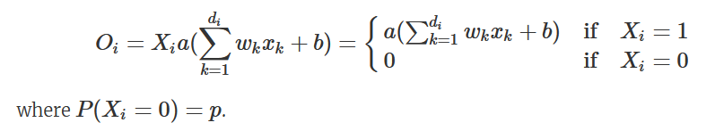

Slide 55
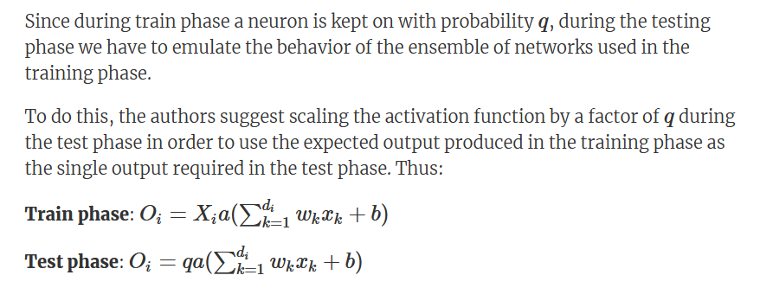
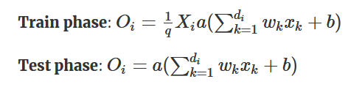
Inverted dropout

Slide 56
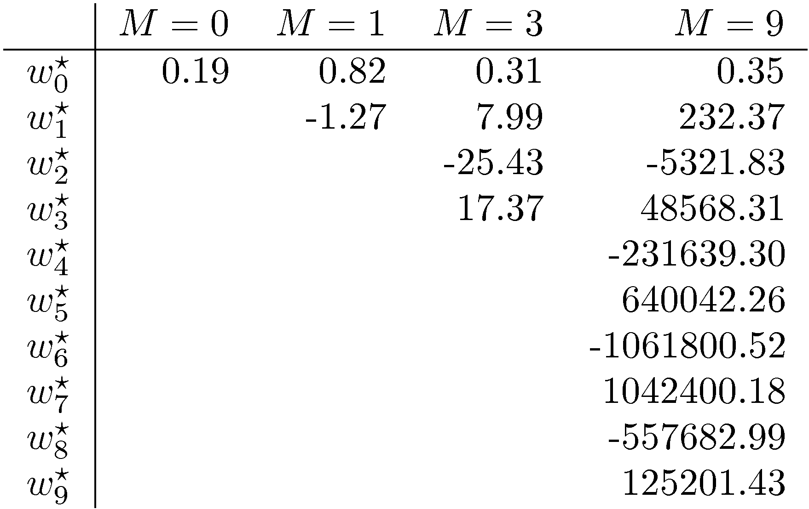

Slide 57
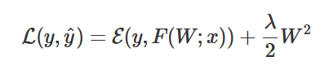
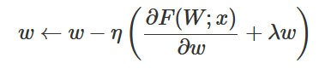
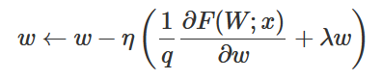
Dropout + L2 normalization
Dropout can’t control the range of values the weight variables can take!
Dropout
Inverted Dropout

Slide 58
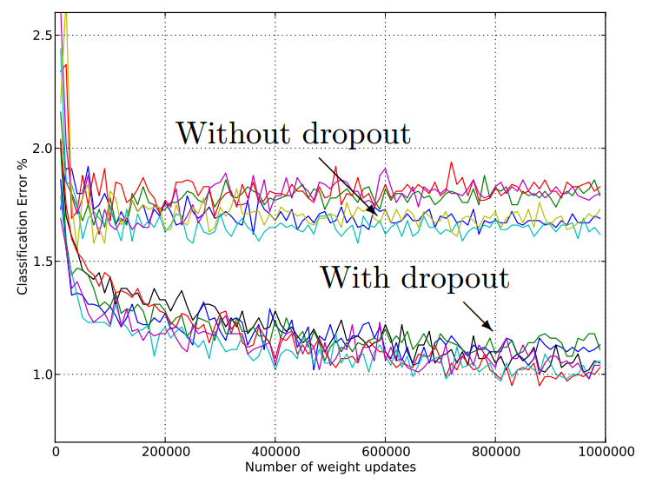

Slide 59
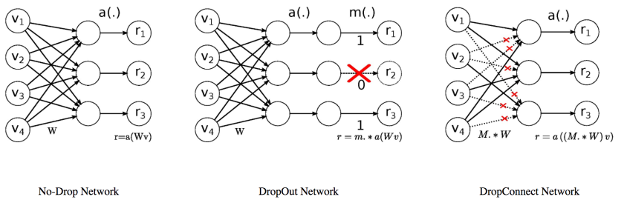
DropConnect

Slide 60
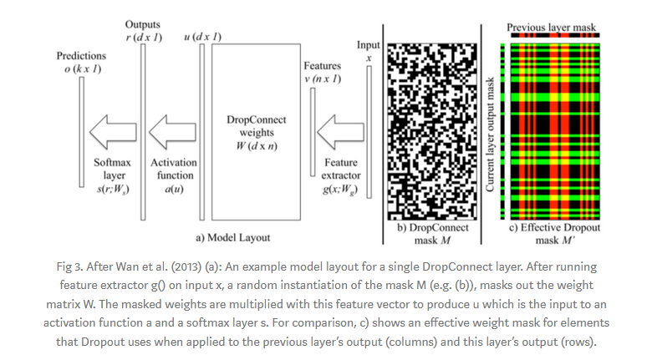

Slide 61

Dropblock

Slide 62

Early stopping – avoid over-training

Slide 63





Data augmentation

Slide 64



Fancy PCA
p denote the
Eigenvector, \lambda
Denote the eigenvalue
\alpha is a random noise
+

Slide 65

Suggested reading

Slide 66

Some comparison

Slide 67


Non-regularized version

Slide 68


L2 regularization

Slide 69


Dropout

Slide 70

Some notes on the ReLU function
Idea of Dying ReLU
Need to ensure some gradient pass if x<0

Slide 71


Leaky, parametric, exponential ReLU

Slide 72


Maxout activation

Slide 73


Slide 74




Slide 75


Gradients everywhere!

Slide 76



Stochastic pooling

Slide 77
Popular CNN architecture
Alexnet
Zfnet
VGG
Inception (v1-v4)
Resnet
Resnext
…

Slide 78

AlexNet

Slide 79
Highlights
First deep net in working mode after LeNet
Eight layers
ReLU non-linearity
To avoid overfitting, some of the layers are skipped randomly during training

Slide 80

Zfnet
Reduced stride to 2 from 4

Slide 81

Highlights
Mainly used for visualization by adding a symmetric decoder
Used unpool payer for upsampling

Slide 82

VGGnet

Slide 83



Network in network
MLP-conv layer
Representations that achieve good
abstraction are non-linear function
of the input data!

Slide 84

Network in network
No learnable parameter!
Can work with images of different resolution!

Slide 85


Slide 86

Inception architecture
What is a good kernel size for DOG feature extraction?

Slide 87



Slide 88

Inception v1 (Googlenet)
9 inception module, 22 layers, global average pooling at the end, 2 intermediate classifier to take care
Of the ‘dying out’ effect

Slide 89


Slide 90


Inception v2
Filter separability and small filter size

Slide 91

Representational bottleneck
Wider network than deeper network
Sudden reduction in depth causes information
Loss – Rep Bottleneck

Slide 92


Slide 93

Inception v3
The auxiliary classifiers do not contribute much except during the end of the training phase!

Slide 94

Label smoothing

Slide 95

Inception v4
Reduce spatial dimensions!

Slide 96

Simplify the “stem”

Slide 97


Slide 98

Going deeper in CNN

Slide 99




Highway network
In plain network
T: Transform gate
C: Carry gate, usually C = 1 - T

Slide 100


Residual networks

Slide 101


Slide 102


Slide 103

Inception resnet

Slide 104


Densely connected CNN

Slide 105


ResNext
Resnext block with cardinality 32

Slide 106


Group convolution

Slide 107


Slide 108


Stochastic depth
Can the depth of the network change during training?
If b=0

Slide 109


Mobilenet
The idea of depthwise
Separable convolution

Slide 110


Slide 111

Depthwise separable convolution
Convolving by 256 5x5 kernels over the input volume

Slide 112


Depthwise separable convolution – step1
Along depth

Slide 113


Depthwise separable convolution – step2
1x1 conv
Pointwise

Slide 114


Slide 115


MobileNet v2

Slide 116


Slide 117


Slide 118

Efficientnet

Slide 119

Visual attention

Slide 120


CBAM – spectral spatial attention

Slide 121

SE ResNet

Slide 122




Idea of self-attention in CNN

Slide 123


Slide 124


Slide 125

What’s wrong with deep CNN?
Pooling causes much information loss

Slide 126

Some design tricks

Slide 127

3D CNN

Slide 128

Must suggested reading

Slide 129
Checking codebase
https://github.com/fchollet/deep-learning-models
Written in Keras

Slide 130

Suggested readings

